Slide 1
Week 13 65 minutes
CS2103/T
Info on the PE and the final exam
While we wait, take look at the Topics-Infographic.pdf in LumiNUS/files/handouts
But first, a recap of the topics (will help in the exam …)

Slide 3




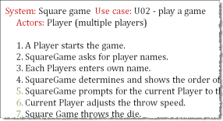
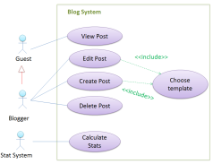
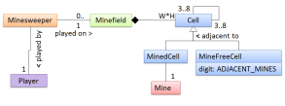
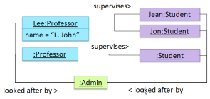
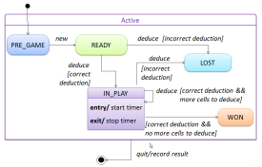
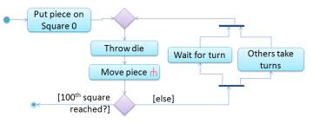


ANALYSIS
Possible Improvements:
Apply OO paradigm
Apply analysis patterns e.g. Abstraction occurrence
Categorize and prioritize requirements
Who are typical stakeholders of a software project?
Why asking the user is not enough?
How do models help to combat complexity?
Why use UML?
When should we prefer use case descriptions over user stories?
Comment on this step that appeared in a use case description: “user clicks the open button”
What does an OODM captures?
What does an object diagram capture?
How to use object diagrams in analysis phase?
What are non-functional requirements?
What’s the difference between requirements and system specification?
(Complex) Problem domain
Stakeholders
Establish requirements
Focus groups
User surveys
Interviews
Brainstorming
Product surveys
Observations
Combat complexity…
Use abstraction, build models
Specify requirements…
Textual descriptions
Feature list
User stories
Use cases
Prototyping
OO domain models
Object diagrams
Activity diagrams
State machine diagrams
UI prototypes
Glossary
Supplementary requirements
…
Requirements Specification

Slide 4
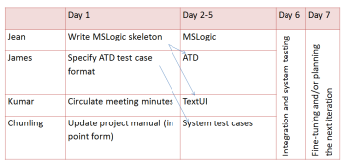
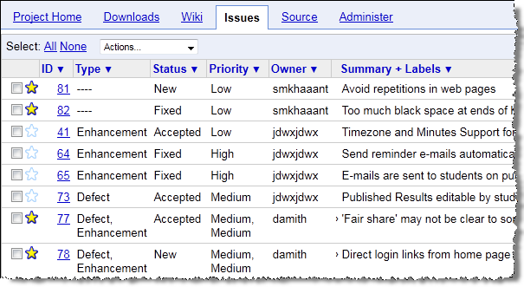
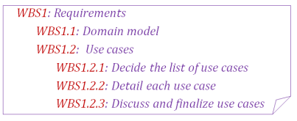
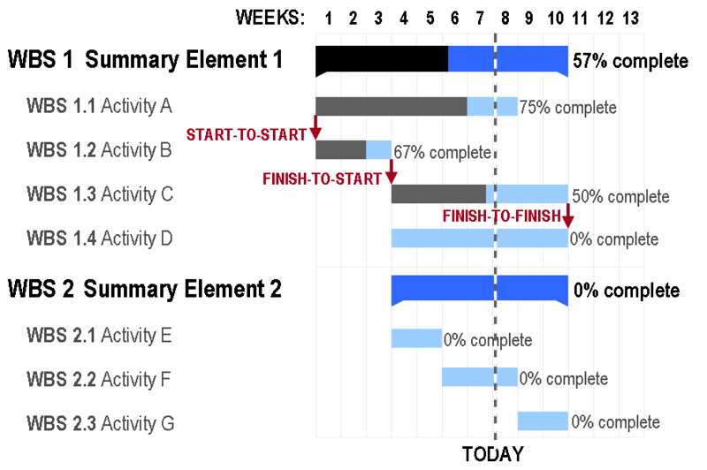
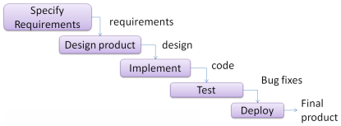

DESIGN
For what purpose do you use sequence diagrams?
Complete this sentence: A is coupled to B if ….
What is a pattern?
What’s the difference between separation of concerns and single responsibility principle?
Architecture styles such as n-tier, client-server, peer-to-peer, broker, pipes-and-filters, service-oriented, transaction-processing, and MVC
System Specification
Architecture
A
C
:A
:B
D
:D
B
Sequence diagrams
Top-down design
Bottom-up design
Possible Improvements:
Use OOP concepts: abstraction, encapsulation, inheritance, polymorphism
↑Cohesion, ↓Coupling
Apply design principles (SOLID, Law of Demeter, Separation of concerns, …)
Apply design patterns (Singleton, Façade, Command, Observer, …)
Is Unified process iterative or sequential?
What’s the difference between buffers and padding?
What’s the benefit of identifying the critical path of a project?
API (Application Programming interface)
B
:x
:y
Class diagrams
y
Project plans
:z
x
z
PROJECT MGT
Work-breakdown structures
More agile → less upfront design
operations
Issue trackers
Sequential
Includes buffers and milestones
design
Unified process
CMMI
Detailed design
Iterative
Agile processes
Breadth-first
Depth-first
XP
Scrum

Slide 5
IMPLEMENTATION
QA
How is refactoring different from bug fixing?
How are assertions different from exceptions?
Is Git centralized or distributed RCS?
What distinguishes a platform from a framework or a library?
Describe CI (Continuous Integration).
Acceptance testing is validation or verification?
Give one pro and one con of white box text case design.
How is integration testing different from unit testing?
How does equivalence partitioning help in increasing E&E of testing?
Give an advantage of TDD.
Which is stronger: statement coverage or path coverage?
What is the purpose of dependency injection?
RCS
= Validation + Verification
Unit testing
A
B
D
C
Other V&V techniques:
formal verification
static analyzers
code reviews
…
Can be top-down, bottom-up, sandwich, big-bang
Developer testing
Integration
Integration testing
Can be late-one-time, or early-and-continuous
Testing
After modifications… Regression testing
Framework
QA
System testing
design
System
Test cases
Library
Platform
Made up as you go → Exploratory testing
Predetermined → Scripted testing
Can be created in these ways:
Black-box, Glass-box, Grey-box
User
Acceptance testing
Alpha/beta testing
Possible Improvements:
Refactor code
Coding standards and good coding practices
Protect code using assertions, exceptions, logging, and defensive coding.
Build automation, Continuous Integration
Possible Improvements:
Automate testing
Use Test-Driven Development
Increase efficiency and effectiveness of testing (Equivalence partitioning, Boundary Value analysis)
Increase test coverage (function/entry/exit/statement/ branch/ condition/path coverage)
isolate SUT using drivers, stubs and dependency injection

Slide 8
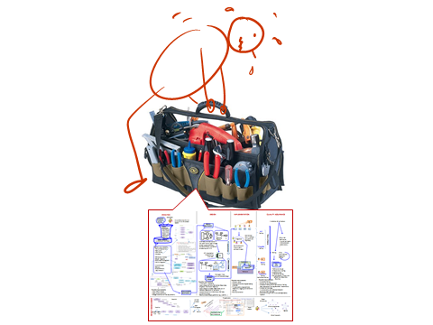
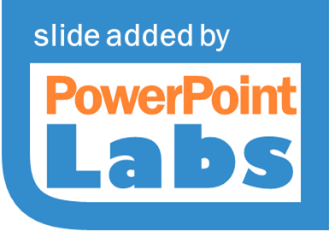
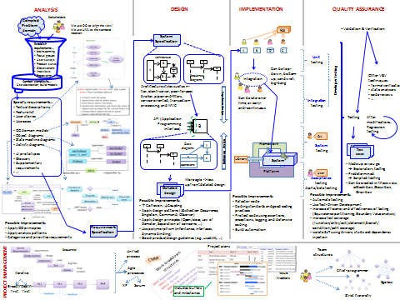

Slide 9

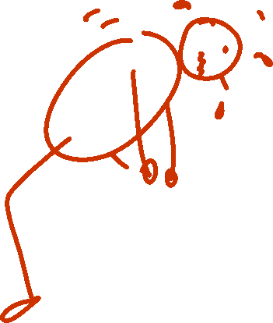

Slide 10

Not enough!
There’s more …
Notes:
You don’t use all of it all the time.
Don’t throw away because you don’t use it all the time.
Know when to use.
Know how to use properly.

Slide 11
PE

Slide 12
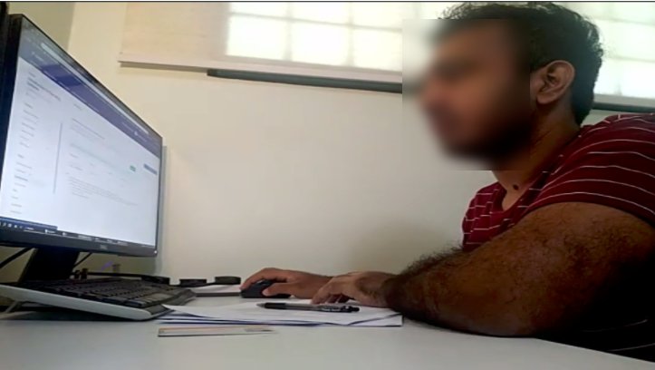
PE procedure
Read all PE instructions (even later phases) in the website
Divided into small Zoom meetings (~25 students)
No admission if the Zoom name and the camera set up is not as expected.
1
4
2
3
Remote PE is the preferred mode but if not feasible for you, we can facilitate F2F mode (more info soon).

Slide 13
Exam

Slide 14
Exam procedure
F2F, using Examplify, your own device (but not iPad)
No Internet, open-book (any hard/soft copies allowed)
Zoom proctoring available if COVID positive:
contact UG office for approval
Zoom set up similar to PE
1
4
2
3

Slide 15
Part 1 (of 3)
15 + 1 MCQ questions
Most MCQs come with a short-answer follow-up question.
35 minutes (~2 minutes per question)
Random order, cannot go back to previous questions
Reduces the risk of cheating, strongly recommended by NUS
Harder? (not exactly)
Tests that you can readily make use of basic concepts (e.g., as you would in a SE project team discussion)

Slide 16
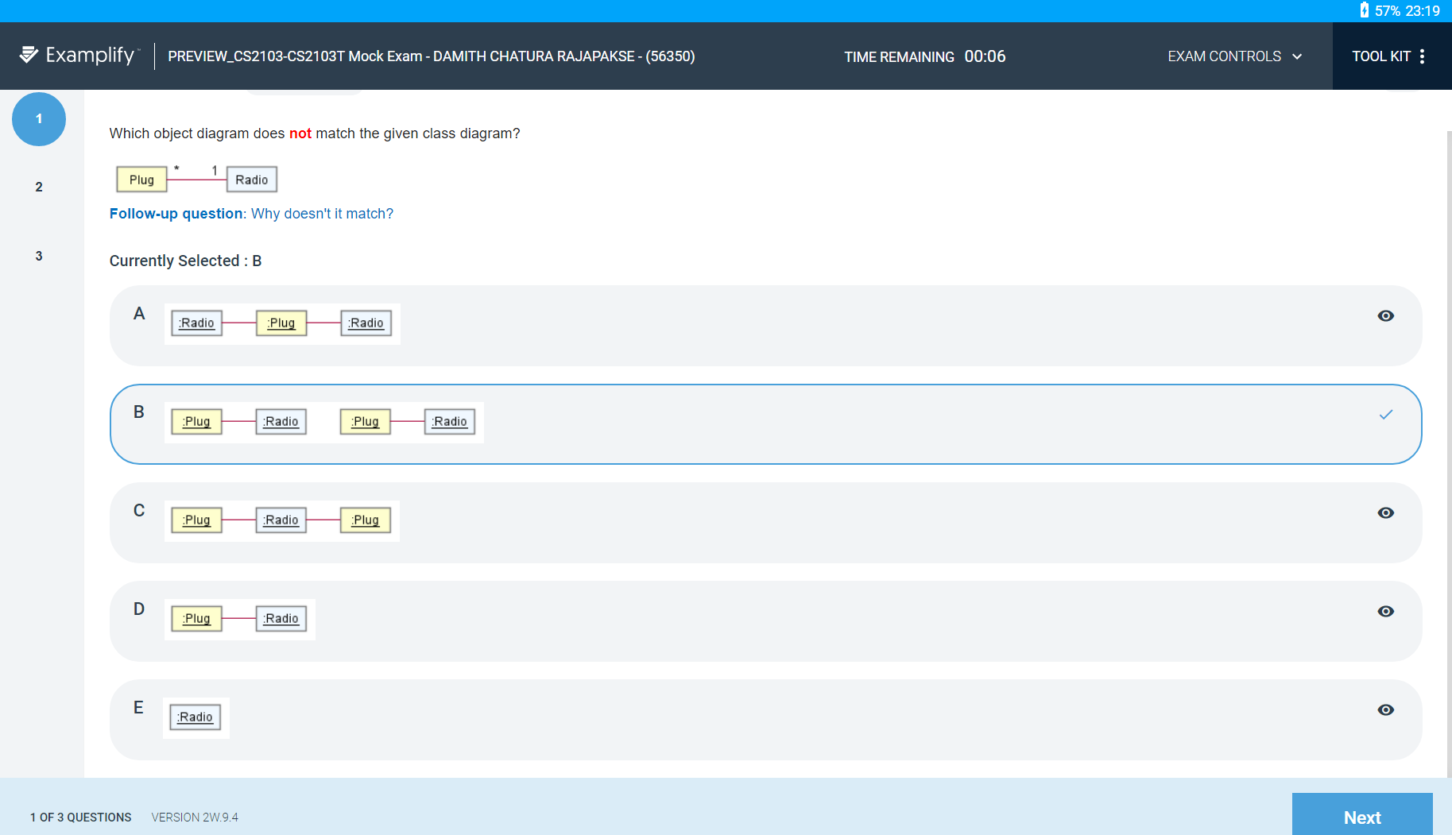

Slide 17
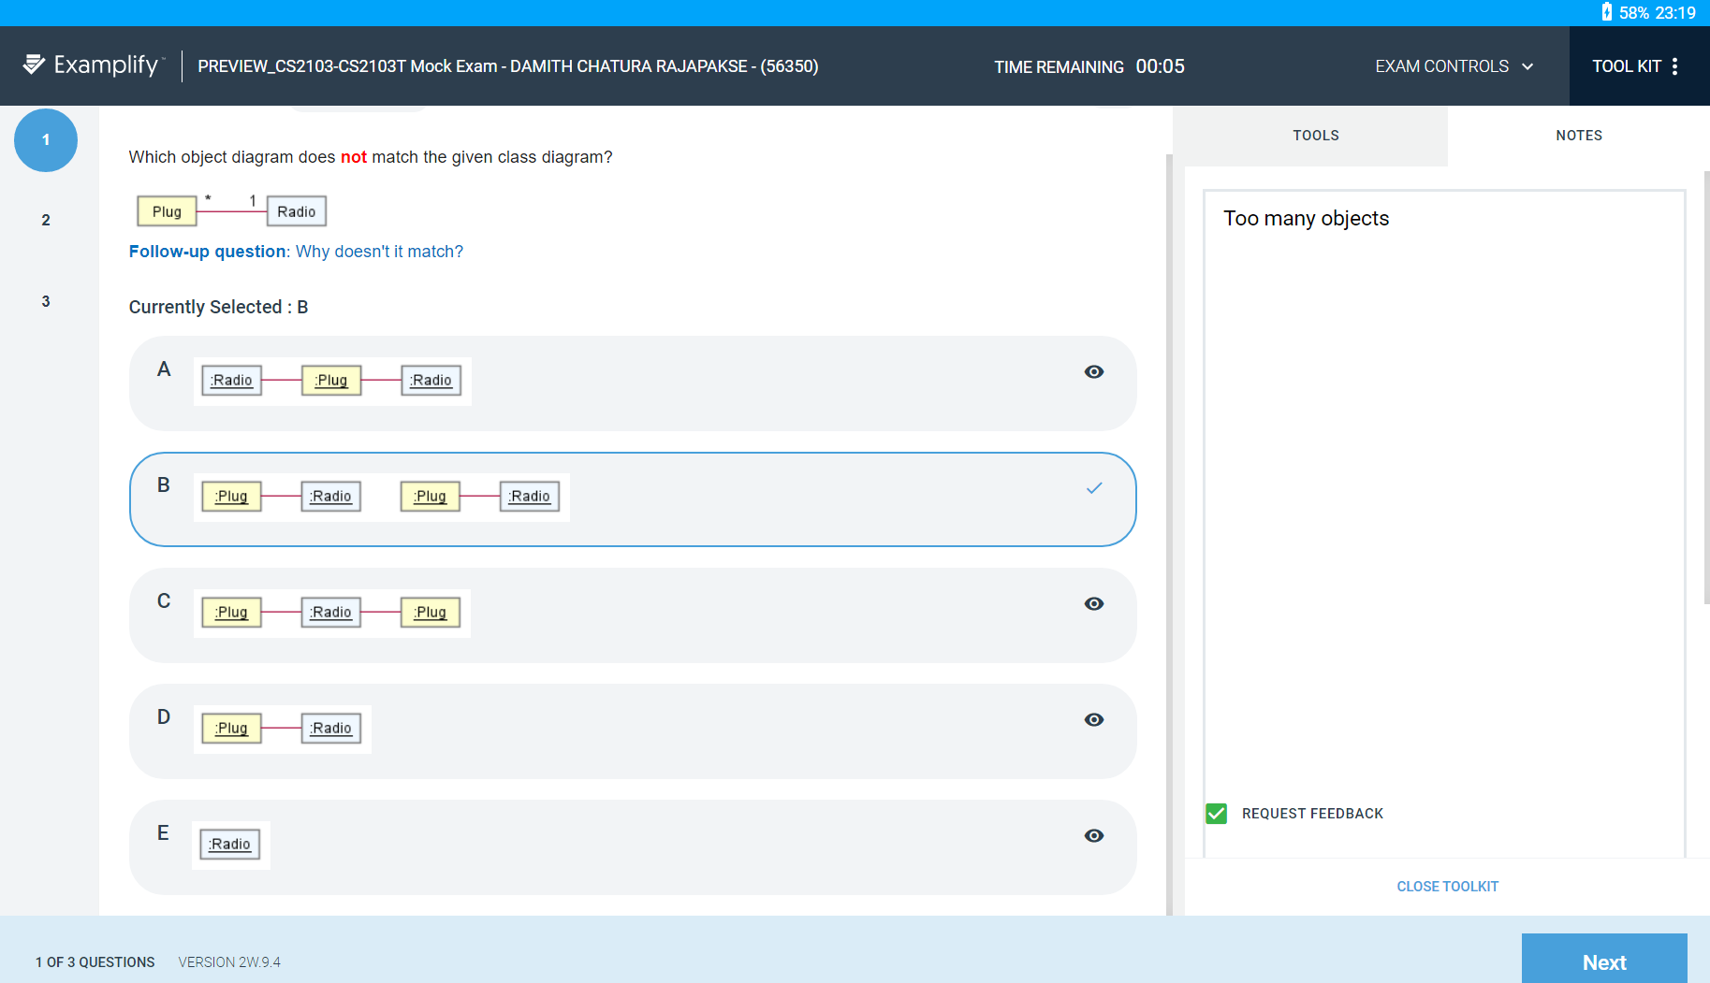
Correct answers to 75% of the follow-up questions should be enough for full marks.
2
3
4

Slide 18
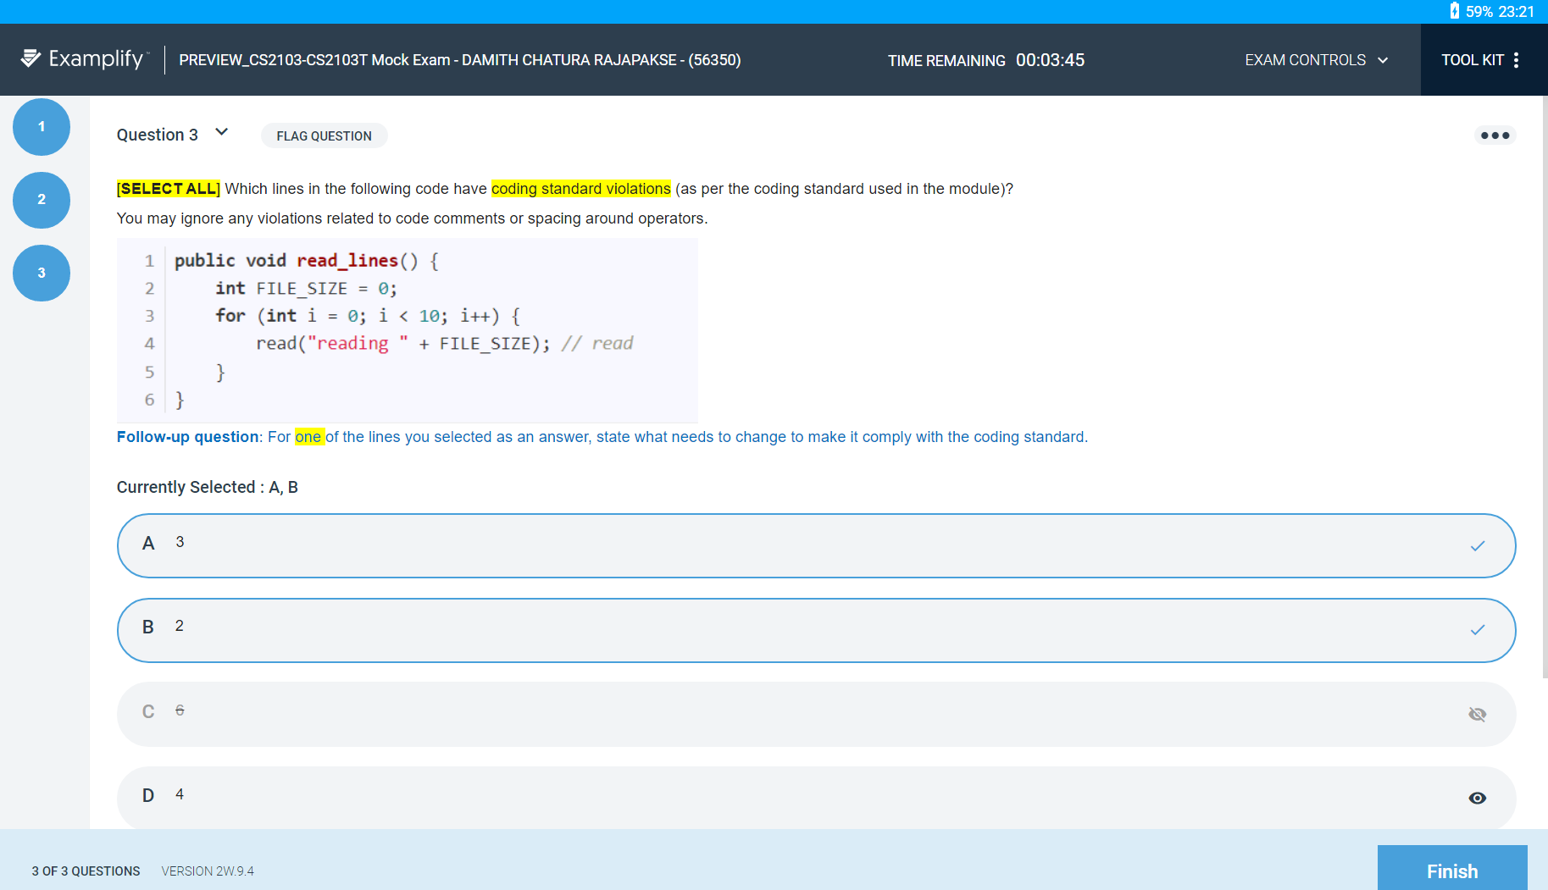
This means this is a checkbox style question
These can be used to eliminate wrong answers

Slide 19
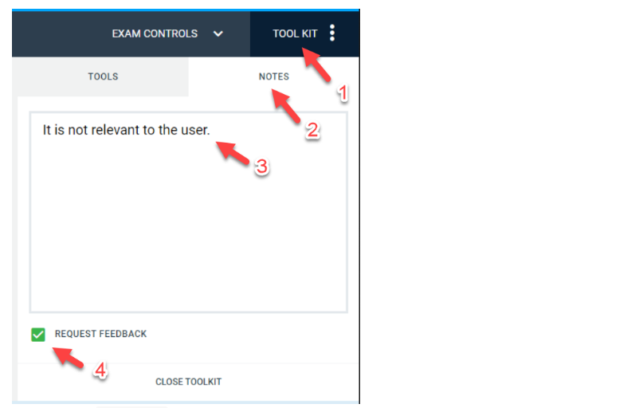
Clarifications not allowed during the exam – state your assumptions along with the answer to the follow-up question.
Doubt: two answers are exactly the same?
[Optional] Using this format will help us distinguish answer from doubts/queries/assumptions
Doubt: ...
Query: ...
Assumption: ...
Alternatively, make a note of doubts/queries/assumptions and email them to me later (before the end of the exam day) – but keep in mind that question numbers and choice numbers are randomized.

Slide 20
Part 2
20 minutes
Draw 2-3 UML diagrams on paper
Similar to diagram sketching in a whiteboard discussion
Bring one or two A4 sheets for this purpose
Instructions in the encrypted PDF file (download in advance, password given at the start)
Diagrams not graded, but you will need those diagrams for part 3
The diagrams can still earn you some consolation marks if you score low for the corresponding part 3 questions
Tip: Draw a minimal diagram first. Add optional details if you have time.
Write student number on top-right corner, and submit before you leave the exam hall.

Slide 21
Part 3
Similar to part 1
Some questions will be based on the UML diagrams you drew earlier
You can update the diagram during part 3 too, but do that only if it helps you (remember, part 2 diagrams are not graded)
example
Which of these partial class diagrams is the best match to the code?
a
b
c
<<interface>> Billable
<<interface>> Billable
{interface} Billable
bill()
bill()
<<abstract>>
Item
{abstract}
Item
{abstract}
Item
+print() {abstract}
+print() {abstract}
d
e

Slide 22
Practice exam paper
Purpose: to practice timing
Released at least 1 week before the exam
About ¾ size of the full exam

Slide 23
Mock exam
Objective: learn the Examplify UI and our exam format
Available on Examplify
Password: hello123
Only 3 questions
Try it well in advance of the actual exam

Slide 24
tP – home stretch!
Great work so far!
I say that every semester
Remainder is the hardest part!
We’ll be switching to summative assessment
Aim to finish strong
Stumbled? Struggled?
This is the question that matters: Can you survive an SE project, even if …?

